Slide 1
INDUSTRY 4.0 REPORT Topic: CPS: Integrating AI and IoT for smart Automation
Team Members: S Riddhi Reddy (RVCE24BEC009) Pranati B (RVCE24BEC041) Prashansa Jaiswal (RVCE24BCV007)

Slide 2
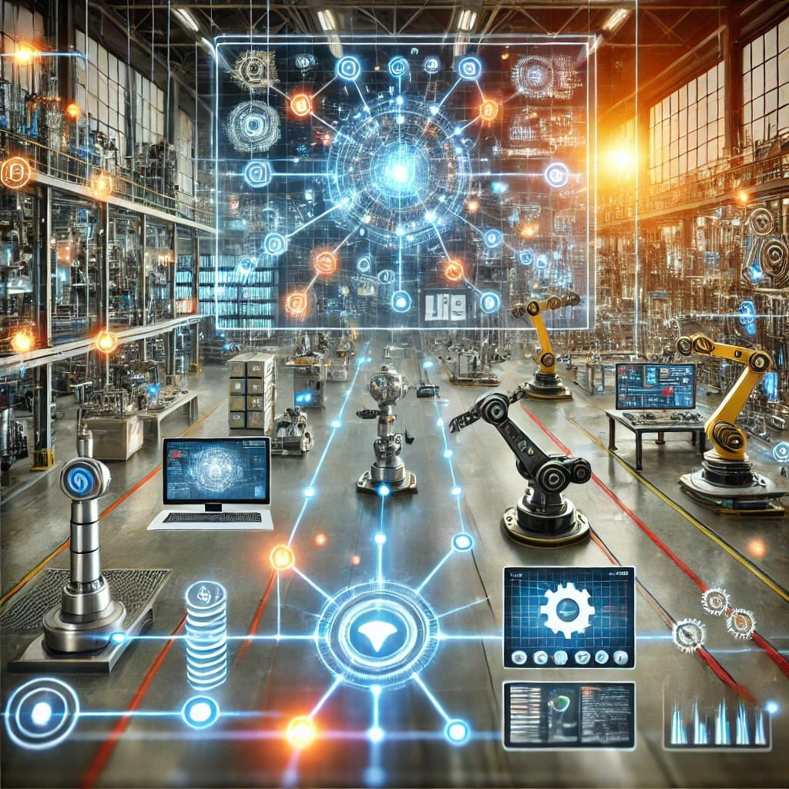
Introduction of Cyber-Physical Systems (CPS):
Cyber-Physical Systems (CPS) are like the bridge between the physical world and the digital world. They combine physical processes with smart computational elements, allowing for real-time monitoring and control. Think of it as giving machines the ability to "think" and "respond" to what's happening around them. These systems play a crucial role in advancing smart manufacturing and powering the vision of Industry 4.0. In this interconnected era, CPS helps businesses streamline operations, make better decisions, and unlock new levels of efficiency.

Slide 3
Cyber-Physical Systems (CPS) Overview:
Cyber-Physical Systems (CPS) are a synthesis of computational and physical components, combining sensors, actuators, and software to form a unified system capable of real-time physical operation monitoring and control. The development of smart manufacturing and the larger idea of Industry 4.0 depend on this connection.
Large volumes of data can be gathered, analyzed, and shared throughout industrial processes thanks to CPS, which promotes increased efficiency and transparency. In industrial settings, this data-driven strategy improves efficiency and enables better decision-making.
CPS (Cyber Physical Systems) enables real-time data collecting, analysis, and automation in a variety of industries, especially manufacturing, by fusing computer and physical processes.
Through the use of cloud computing, artificial intelligence (AI), and Internet of Things (IoT) devices, the technology facilitates the shift to Industry 4.0 by improving connection, efficiency, and decision-making.

Slide 4
Important Ideas and Uses:
Smart Manufacturing: By enabling automation, predictive maintenance, and real-time monitoring, CPS makes smart factories possible, which eventually boosts output and decreases downtime. It is essential to the conversion of conventional production into smart manufacturing. This change leads to better product quality, lower operating costs, and optimized production procedures.
Analysis of Bottlenecks (BA): The detection, diagnosis, prediction, and prescribing phases of a framework for BA employing Cloud-Based Cyber-Physical Systems (CB-CPSs) to perform bottleneck analysis. The four phases of this approach are diagnosis (examining the reasons), prediction (projecting future bottlenecks), prescription (offering solutions), and detection (finding bottlenecks). Manufacturers can improve throughput and operating efficiency using this methodical approach.
Digital Twins: One of the main elements of CPS is the idea of digital twins. Digital twins are virtual versions of real-world systems that enable ongoing simulation, monitoring, and manufacturing process optimization. They lower risks and increase efficiency by allowing producers to test modifications and forecast results in a virtual setting before putting them into practice in the real world.

Slide 5
Benefits of CPS in Industry 4.0:
Enhanced Productivity: CPS dramatically raises manufacturing operations' productivity levels by automating procedures and offering real-time data. Faster production cycles and increased ability to satisfy market demands result from this.
Improved Quality Control: Early defect and quality issue detection is made possible by real-time data analytics and monitoring capabilities, which enable prompt actions that reduce waste and rework.
Improved Resource Management: CPS makes it possible to use resources more efficiently, such as energy management and inventory control, which lowers costs and promotes sustainability.
Better Decision-Making: Manufacturers may respond more swiftly to operational difficulties and market changes by using their abilities to evaluate massive datasets to make well-informed decisions.
In brief,
Improved manufacturing process efficiency and productivity.
Real-time data analytics resulted in improved quality control and fewer errors.
Better resource management and energy efficiency.
Improved decision-making capabilities through data-driven insights.

Slide 6
Challenges and Considerations:
Cybersecurity Risks: CPS is susceptible to cyberattacks due to the growing interconnectedness of devices and systems. Maintaining operational integrity and safeguarding sensitive data require strong cybersecurity measures.
Integration Issues: A lot of businesses have trouble integrating CPS with their current legacy systems, which can prevent them from reaping the full benefits of Industry 4.0. To fully utilize CPS technologies, seamless integration is necessary.
Problems with Data Management: Managing the enormous volumes of data produced by CPS presents difficulties with regard to privacy, data accuracy, and regulatory compliance. To solve these problems, effective data governance techniques are required.
Skilled staff Requirements: A staff with specialized skills in fields like data analytics, IoT, and cybersecurity is needed for the deployment and upkeep of CPS technology. To gain this competence, organizations need to make training and development investments.
In brief,
Cybersecurity threats brought on by greater connectivity and reliance on digital systems.
Difficulties integrating with current legacy technology and systems.
Concerns about data management, such as data accuracy and privacy.
The need for a skilled workforce to implement and maintain CPS technologies.

Slide 7
Future Directions:
With continuous developments in artificial intelligence (AI) and machine learning (ML) anticipated to expand CPS's capabilities, the future of CPS in Industry 4.0 appears bright. More autonomous systems that can adjust to shifting circumstances and make wise decisions will be made possible by these technologies.
Sustainability is becoming more and more important in manufacturing, and CPS provides chances to cut down on waste, energy use, and carbon emissions. As industries work toward environmental responsibility, sustainable practices will become more and more significant.
The complexity of manufacturing environments will make the development of advanced data analytics and management strategies essential. In order to derive useful insights from the data produced by CPS, organizations will need to implement sophisticated analytical tools.
In brief,
The ongoing development of CPS to allow for smarter, more independent systems through developments in AI and machine learning.
Increased focus on ecologically friendly and sustainable production methods.
Creation of increasingly complicated data analytics and management strategies to accommodate manufacturing settings' increasing complexity.

Slide 8
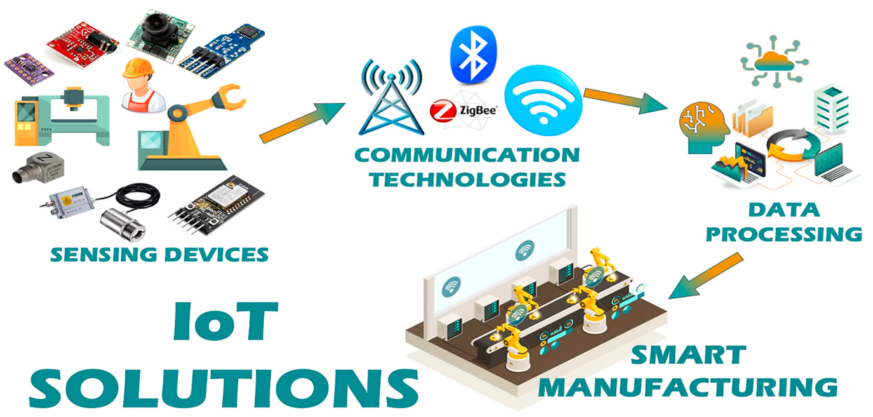
Summary:
Cyber-Physical Systems are essential to the development of Industry 4.0 and offer a wealth of chances for industrial innovation, efficiency, and sustainability. But for implementation to be successful, a number of issues must be resolved, such as workforce development, data management, integration, and
cybersecurity. CPS technologies will become more and more important in determining how manufacturing and industrial operations develop in the future.

Slide 9
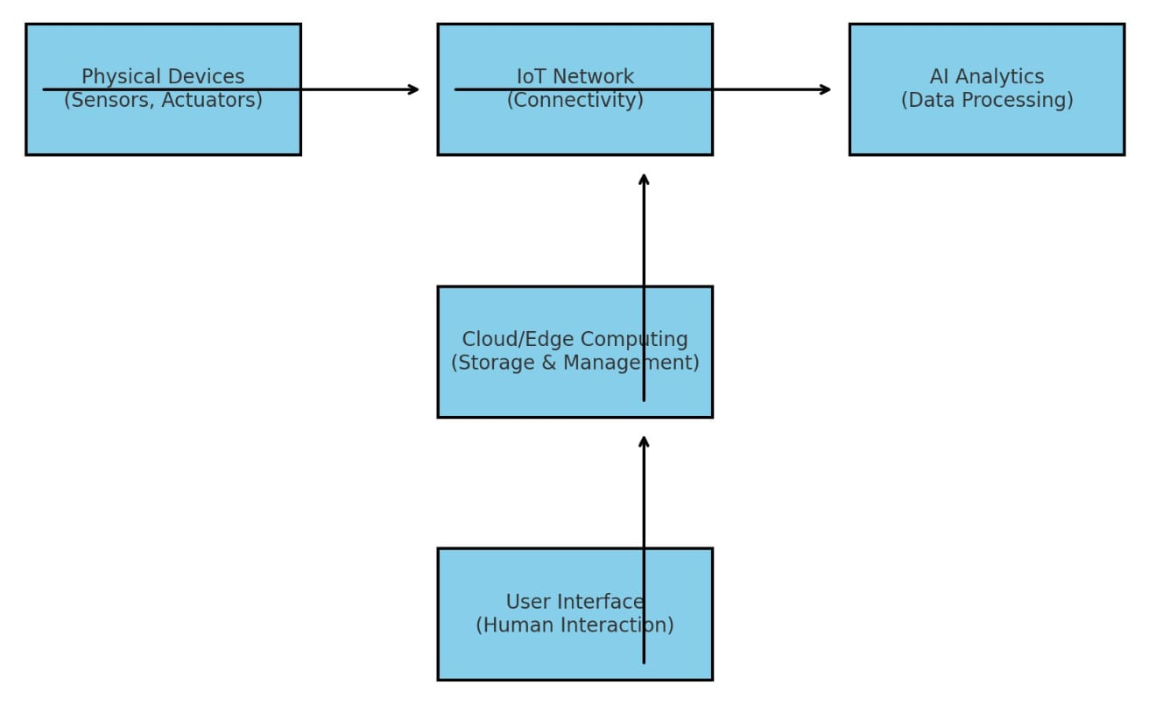
Report on Recent Advances in Cyber-Physical Systems and IoT in Healthcare and Smart Cities
Introduction: This report brings together insights from the recent articles exploring how Cyber-Physical Systems (CPS) and the Internet of Things (IoT) are reshaping key areas like healthcare and smart cities. These technologies have the potential to revolutionize how we live and work by improving efficiency, enhancing healthcare, and tackling urban challenges like traffic congestion and resource management.

Slide 10
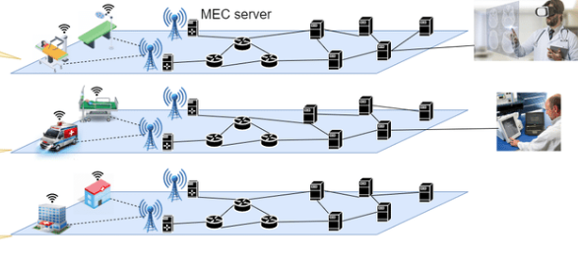
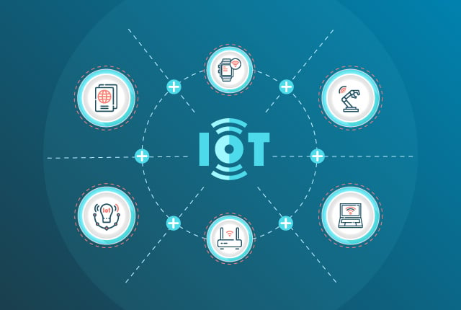
1. 5G Network Slicing for Digital Healthcare: Dives into how 5G network slicing can create a real-time digital healthcare system. Imagine wearable devices that constantly monitor your health, collecting biometric data and using AI to make predictions or recommend treatments instantly. The study highlights the importance of secure and reliable communication networks, focusing on keeping sensitive patient data private while ensuring healthcare systems run smoothly.
2. Intelligent IoT Firmware Compliance Testing: Addresses a big issue with IoT devices: security. With so many IoT gadgets popping up, ensuring they’re safe and compliant is a huge challenge. This article presents a smart system that tests firmware for vulnerabilities using both static and dynamic analysis. By examining over 4,300 firmware samples, the researchers found numerous security gaps, underscoring the urgent need for better practices in IoT development and manufacturing.

Slide 11
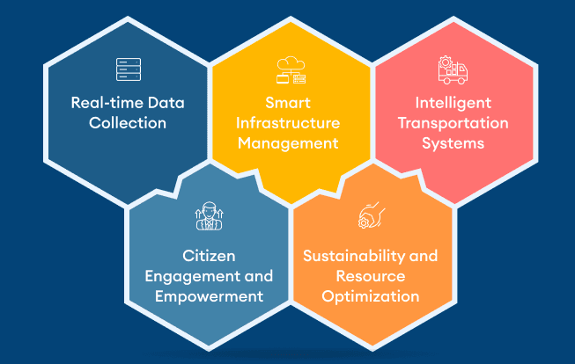
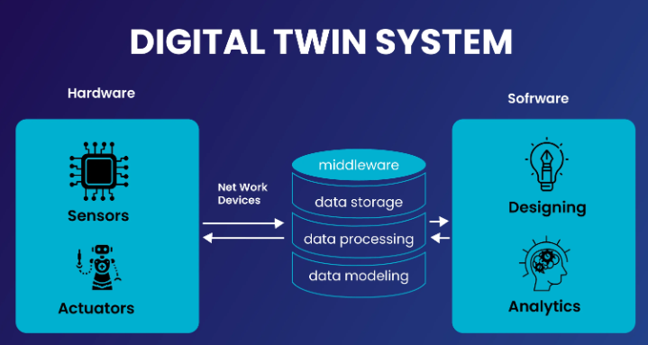
3. Proactive Role of IoT Devices in Smart Cities: Exploring the bustling streets of smart cities, where IoT devices are helping make urban life more efficient. One example is smart traffic lights that adjust to real-time traffic conditions, reducing delays and keeping things moving. The study also looks at how residents perceive smart city services compared to traditional setups, and the results are clear—people are much happier with the convenience and efficiency of smart city systems.
4. Integration of AI and Digital Twins in Manufacturing: Focusing on manufacturing, showing how AI and digital twins are transforming factories. Digital twins are like virtual replicas of physical systems, enabling real-time monitoring and predictive maintenance. Paired with AI, they’re making factories smarter, more efficient, and capable of adapting to changing demands. This combination is a game-changer for the manufacturing industry, paving the way for streamlined operations and better decision-making.

Slide 12
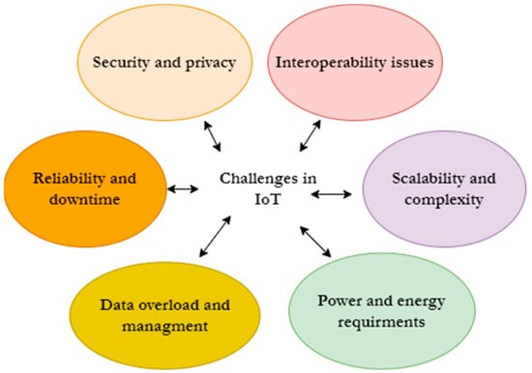
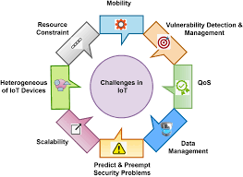
5. Challenges and Future Directions in CPS and IoT: Addressing the challenges these technologies face. From cybersecurity threats to difficulties integrating with older systems, there’s a lot to overcome. The authors stress the need for robust security measures, better analytics tools, and a skilled workforce to support the growing demands of CPS and IoT. They also call for continued innovation to ensure these technologies reach their full potential.
Conclusion:
Cyber-Physical Systems and IoT are driving incredible changes in healthcare and urban living. These technologies can make systems more efficient, improve services, and help solve complex problems. But it’s not all smooth sailing—security, integration, and training are significant hurdles we need to address. By investing in research and innovation, we can unlock the full benefits of CPS and IoT, shaping a smarter and more connected future for everyone.

Slide 13
References:
Mohd Javaid, An integrated outlook of Cyber–Physical Systems for Industry 4.0: Topical practices, architecture, and applications; Green Technologies and Sustainability 1 (2023) 100001
Ehsan Mahmoodi A framework for throughput bottleneck analysis using cloud based cyber-physical systems in Industry 4.0 and smart manufacturing Procedia Computer Science 232 (2024) 3121–3130
Milan Groshev Toward Intelligent Cyber-Physical Systems: Digital Twin Meets Artificial Intelligence IEEE Communications Magazine • August 2021
Sayawu Yakubu Diaba Cyber-physical attack and the future energy systems: A review; Energy Reports 12 (2024)
Hemant Jain 5G network slice for digital real-time healthcare system powered by network data analytics; Internet of Things and Cyber-Physical Systems 1 (2021)
Mohan Krishna Kagita A framework for intelligent IoT firmware compliance testing; Internet of Things and Cyber-Physical Systems 1 (2021)
Shahzad Ashraf A proactive role of IoT devices in building smart cities; Internet of Things and Cyber-Physical Systems 1 (2021)
Amit Kumar Tyagi Cyber Physical Systems: Analyses, challenges and possible solutions; Internet of Things and Cyber-Physical Systems 1 (2021)
Hailin Feng Sensible and secure IoT communication for digital twins, cyber twins, web twins; Internet of Things and Cyber-Physical Systems 1 (2021)
Jean-Paul Cyber-physical systems security: Limitations, issues and future trends; J.A. Yaacoub, O. Salman and H.N. Noura et al. / Microprocessors and Microsystems 77 (2020)
Roberto Canonico Industrial cyber-physical systems protection: Amethodological review; Computers & Security 135 (2023)

Slide 14
THANKYOU

